Slide 1
8
VECTORS AND THE
GEOMETRY OF SPACE
Copyright © Cengage Learning. All rights reserved.

Slide 2
8.3
The Dot Product
Copyright © Cengage Learning. All rights reserved.

Slide 3
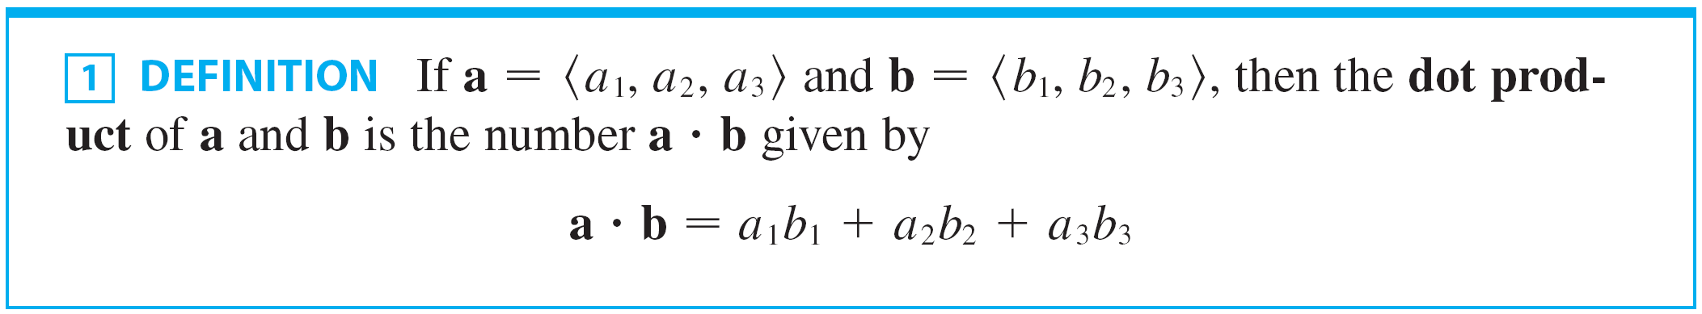
The Dot Product
The formal definition of the dot product is as follows:
Thus to find the dot product of a and b we multiply corresponding components and add.
The result is not a vector. It is a real number, that is, a scalar. For this reason, the dot product is sometimes called the scalar product (or inner product).

Slide 4

The Dot Product
Although Definition 1 is given for three-dimensional vectors, the dot product of two-dimensional vectors is defined in a similar fashion:

Slide 5
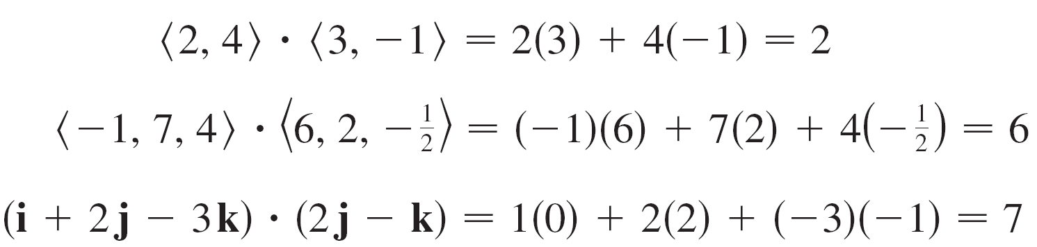
Example 1

Slide 6
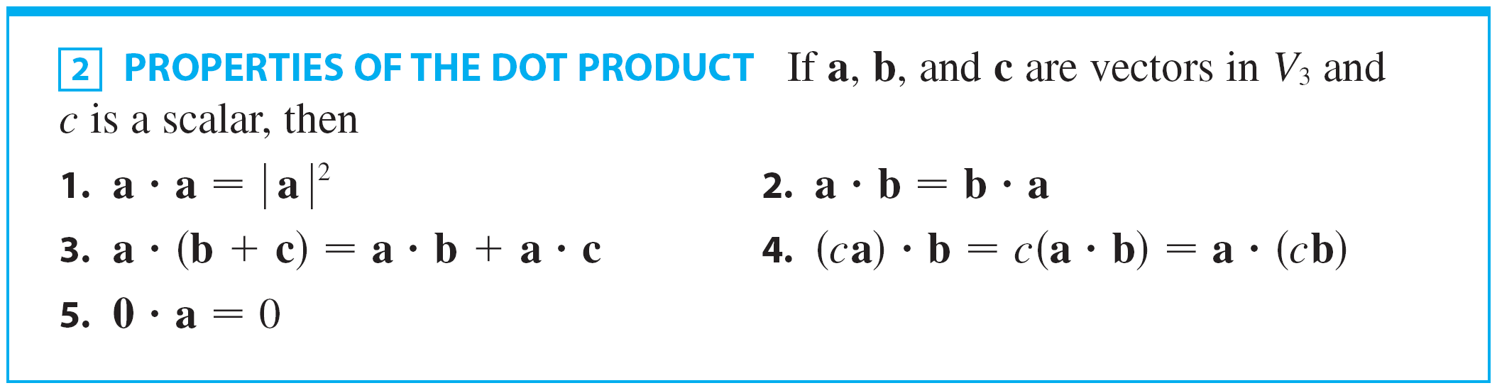
The Dot Product
The dot product obeys many of the laws that hold for ordinary products of real numbers. These are stated in the following theorem.

Slide 7
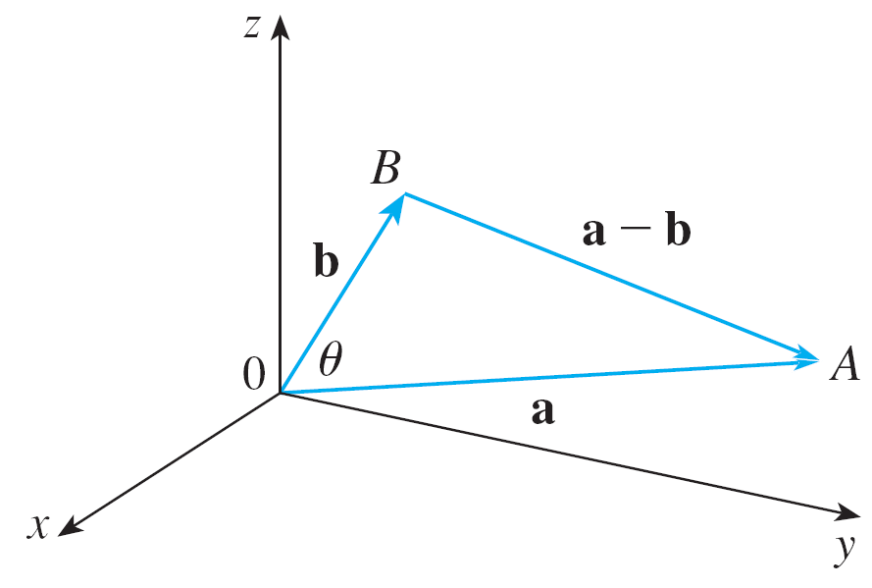

The Dot Product
The dot product a b can be given a geometric interpretation in terms of the angle θ between a and b, which is defined to be the angle between the representations of a and b that start at the origin, where
0 ≤ θ ≤ π.
In other words, θ is the angle
between the line segments
and in Figure 1.
Figure 1

Slide 8
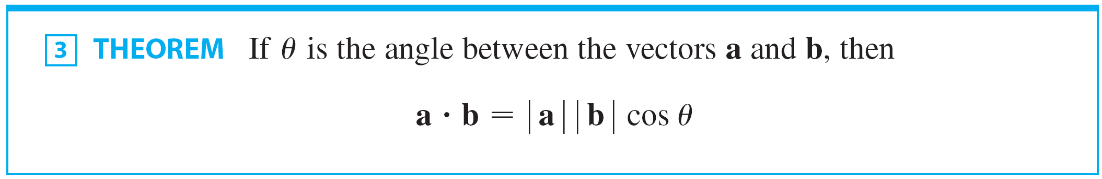
The Dot Product
Note that if a and b are parallel vectors, then θ = 0 or θ = π.
The formula in the following theorem is used by physicists as the definition of the dot product.

Slide 9
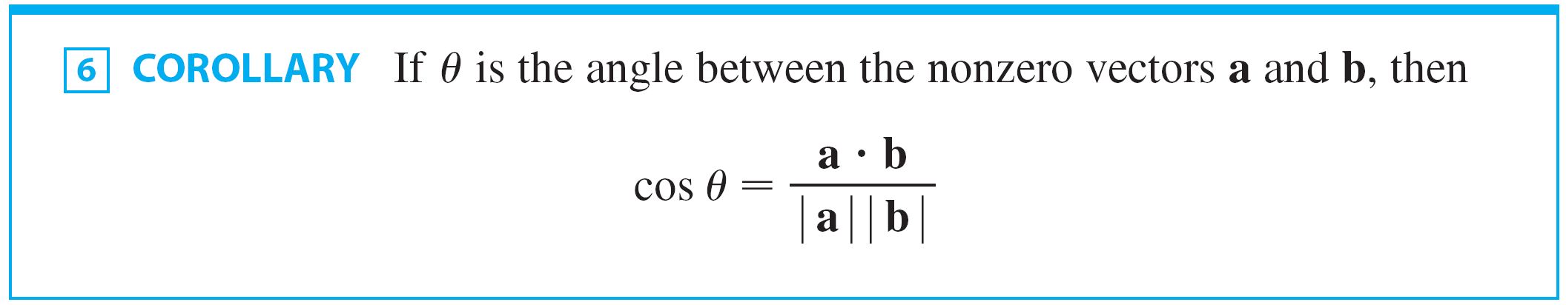
The Dot Product
The formula in Theorem 3 also enables us to find the angle between two vectors.

Slide 10
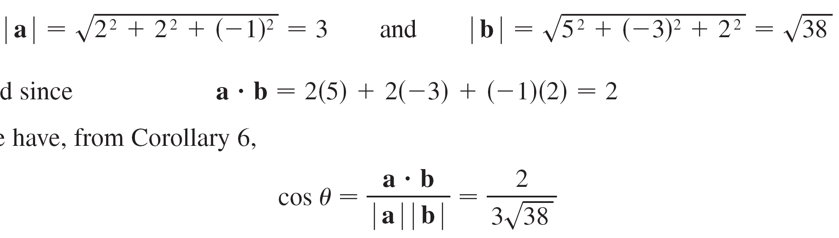
Example 3
Find the angle between the vectors a = ⟨2, 2, –1⟩ and
b = ⟨5, –3, 2⟩.
Solution:
Since
and
and since
we have, from Corollary 6,

Slide 11
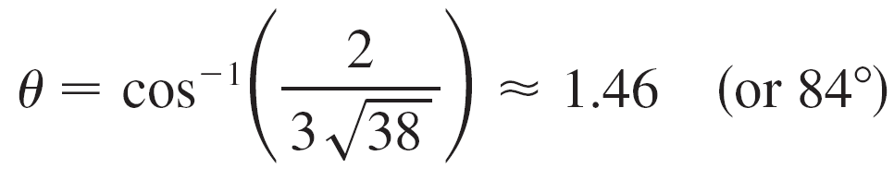
Example 3 – Solution
cont’d
So the angle between a and b is

Slide 12

The Dot Product
Two nonzero vectors a and b are called perpendicular or orthogonal if the angle between them is θ = π /2. Then Theorem 3 gives
and conversely if a b = 0, then cos θ = 0, so θ = π /2. The zero vector 0 is considered to be perpendicular to all vectors.

Slide 13
The Dot Product
Therefore we have the following method for determining whether two vectors are orthogonal.
Because cos θ > 0 if 0 ≤ θ < π /2 and cos θ < 0 if π /2 <θ ≤ π, we see that a b is positive for θ < π /2 and negative for
θ > π /2.
We can think of a b as measuring the extent to which a and b point in the same direction.

Slide 14
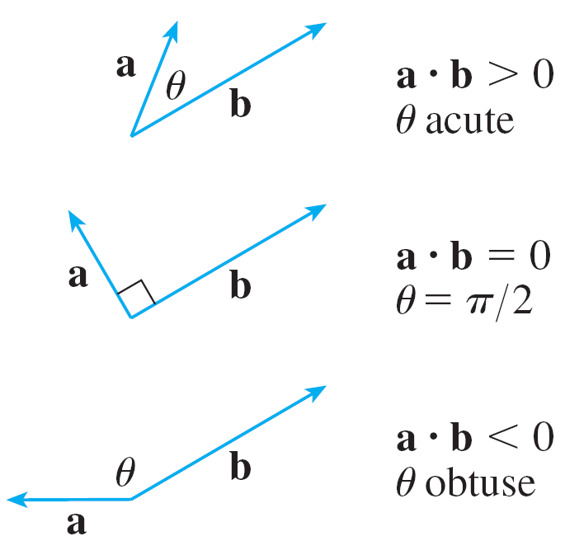
The Dot Product
The dot product a b is positive if a and b point in the same general direction, 0 if they are perpendicular, and negative if they point in generally opposite directions (see Figure 2).
Figure 2

Slide 15


The Dot Product
In the extreme case where a and b point in exactly the same direction, we have θ = 0, so cos θ = 1 and
If a and b point in exactly opposite directions, then θ = π and so cos θ = –1 and

Slide 16
Projections

Slide 17

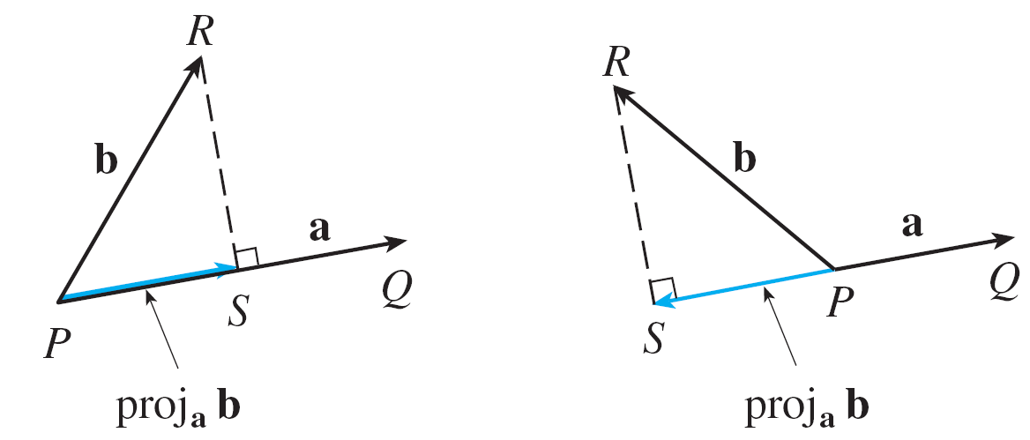
Projections
Figure 3 shows representations and of two vectors a and b with the same initial point P.
Vector projections
Figure 3

Slide 18


Projections
If S is the foot of the perpendicular from R to the line containing , then the vector with representation is called the vector projection of b onto a and is denoted by proj_{a} b. (You can think of it as a shadow of b).
The scalar projection of b onto a (also called the component of b along a) is defined to be the signed magnitude of the vector projection, which is the number,
cos θ , where θ is the angle between a and b.

Slide 19
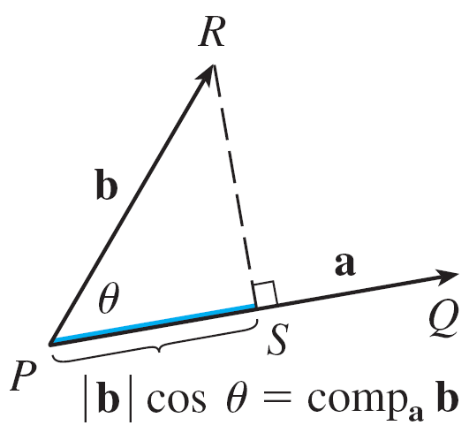
Projections
(See Figure 4.) This is denoted by comp_{a} b. Observe that it is negative if π /2 <θ ≤ π.
Scalar projection
Figure 4

Slide 20
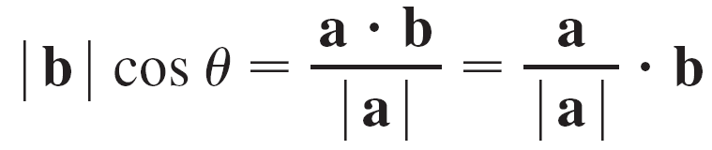
Projections
The equation
shows that the dot product of a and b can be interpreted as the length of a times the scalar projection of b onto a.
Since
the component of b along a can be computed by taking the dot product of b with the unit vector in the direction of a.

Slide 21
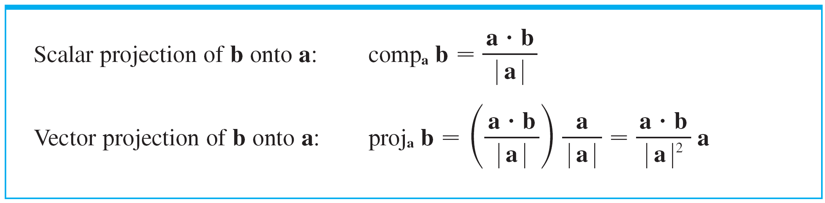
Projections
To summarize:

Slide 22
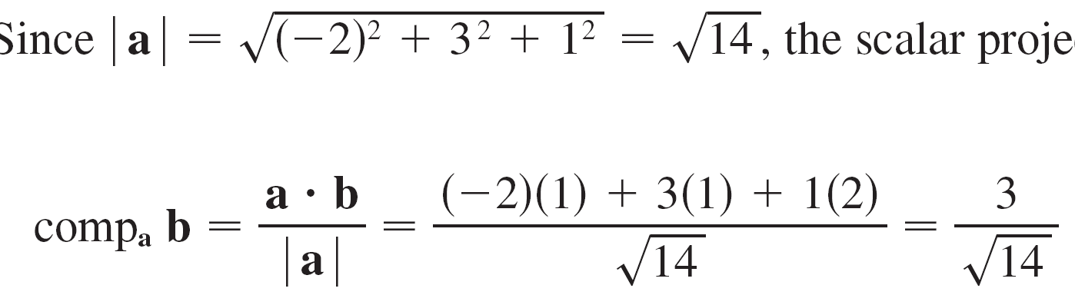
Example 5
Find the scalar projection and vector projection of
b = ⟨1, 1, 2⟩ onto a = ⟨–2, 3, 1⟩.
Solution:
Since , the scalar projection of b onto a is

Slide 23
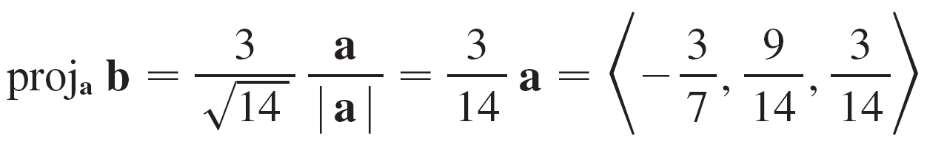
Example 5 – Solution
cont’d
The vector projection is this scalar projection times the unit vector in the direction of a:

